Slide 1

AVRO

Slide 2


Slide 3
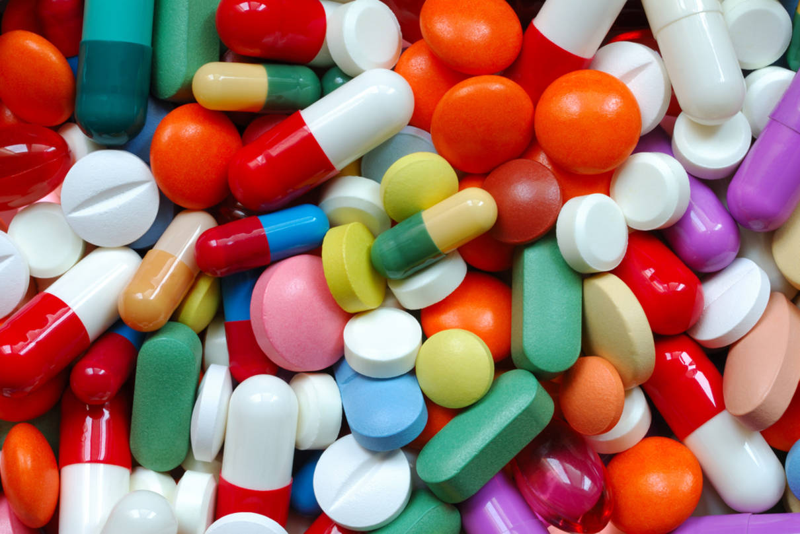

Slide 4
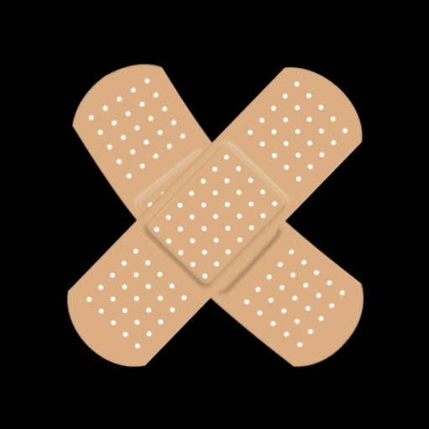

Slide 5
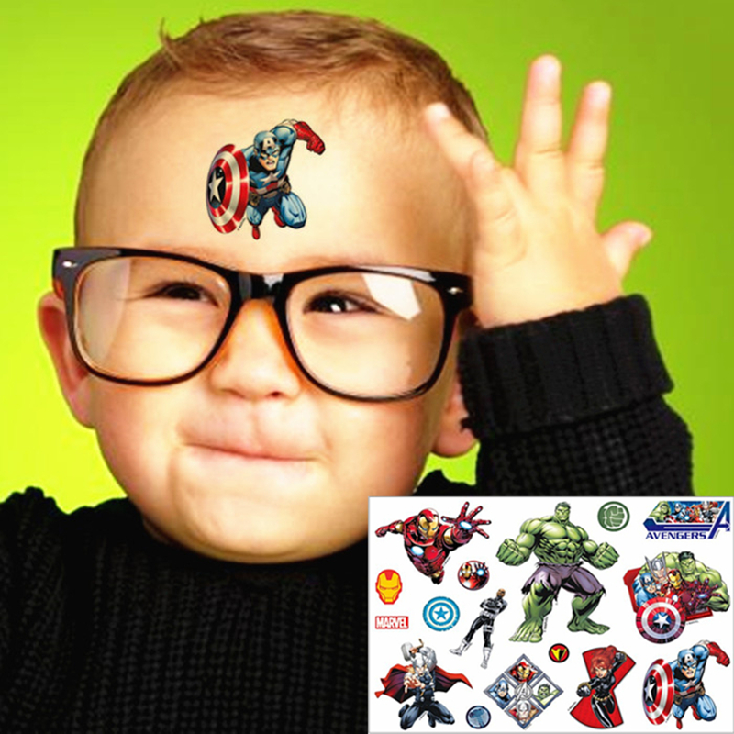
Notes:
Show someone actually with a sticker (doesn’t have to be medicated)

Slide 6
Transdermal Patch
$7B
Antihistamine
$15B
Notes:
Only numbers

Slide 7

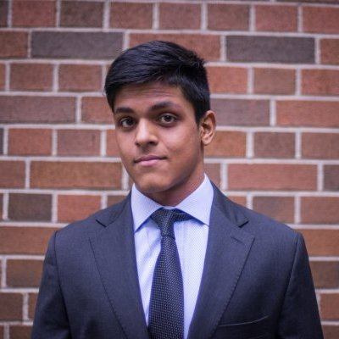

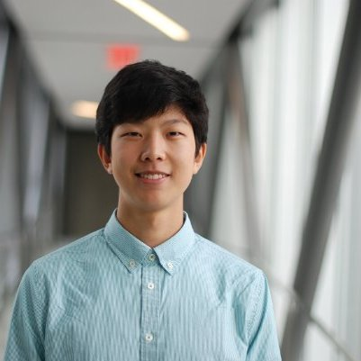


Keean
Honours Science & PharmD Candidate
Shak
Chemical Engineering
Jiwoo
Mechatronics Engineering
Tom
Honours Science & PharmD Candidate
Notes:
Bigger names and no programs
Makes pictures same sizes

Slide 8





Slide 9
AVRO
No pills, no pain, just a patch.

